Slide 1
Online consumer decision making

Slide 2
Agenda
Online consumer decision making
Introduction
Context effects
Primacy/recency effects
Further effects
Personality and social psychology
Discussion and summary
Literature

Slide 3
Introduction
The understanding of online users' purchasing behavior is of high importance for companies
This purchasing behavior can be explained by different models of human decision making
Research has clearly pointed out that preference stability in decision processes does not exist
For instance, a customer who purchases a digital camera could first define a strict upper limit for the price of the camera, but because of additional technical information about the camera, the customer could change his or her mind and significantly increase the upper limit of the price.
The nonexistence of stable preferences led to the development of different alternative decision models, which are discussed in the following

Slide 4
Effort accuracy framework
Model focuses on cost-benefit aspects
A decision process is interpreted as a tradeoff between the decision making effort and the accuracy of the resulting decision
Based on the idea that human decision behavior is adaptive and that consumers dispose of a number of different decision heuristics that they apply in different decision contexts
The quality of consumer decision support in terms of perceived usefulness and ease of use has an important impact on a consumer's behavioral intentions
For example, in terms of reusing the recommender system in the future

Slide 5
Preference construction - Theories from cognition and decision psychology
Theory | Description
Context effects | Additional irrelevant (inferior) items in an item set significantly influence the selection behavior
Primacy/recency effects | Items at the beginning and the end of a list are analyzed significantly more often than items in the middle of a list
Framing effects | The way in which different decision alternatives are presented influences the final decision taken
Priming | If specific decision properties are made more available in memory, this influences a consumer's item evaluations
Defaults | Preset options bias the decision process

Slide 6
Preference construction - Theories from personality and social psychology
Theory | Description
Internal vs. external LOC | Externally influenced users need more guidance; internally controlled users want to actively and selectively search for additional information
Need for closure | Describes the individual pursuit of making a decision as soon as possible
Maximizer vs. satisficer | Maximizers try to find an optimal solution; satisficers search for solutions that fulfill their basic requirements
Conformity | A person's behavior, attitudes, and beliefs are influenced by other people
Trust | A person's behavioral intention is related to factors such as the willingness to buy
Emotions | Mental states triggered by an event of importance for a Person
Persuasion | Changing attitudes or behaviors

Slide 7
Context effects
The way in which we present different item sets to a consumer can have an enormous impact on the outcome of the overall decision process
A decision is always made depending on the context in which item alternatives are presented
Additions of completely inferior item alternatives can trigger significant changes in choice behaviors
Different context effects are presented in the following

Slide 8
Compromise effect
The addition of alternative D (the decoy alternative) increases the attractiveness of alternative A because, compared with product D, A has only a slightly lower download limit but a significantly lower price
Thus A appears to be a compromise between the product alternatives B and D
D is a so-called decoy product, which represents a solution alternative with the lowest attractiveness
Product | A | B | D
price per month | 30 | 20 | 50
download limit | 10GB | 6GB | 12GB

Slide 9
Asymmetric dominance effect
Product A dominates D in both dimensions (price and download limit)
Product B dominates alternative D in only one dimension (price)
The additional inclusion of D into the choice set could trigger an increase of the selection probability of A
Product | A | B | D
price per month | 30 | 20 | 50
download limit | 10GB | 6GB | 12GB

Slide 10
Attraction effect
Product A is a little bit more expensive but of significantly higher quality than D
The introduction of product D would induce an increased selection probability for A
Product | A | B | D
price per month | 30 | 250 | 28
download limit | 10GB | 36GB | 7GB

Slide 11
Summary of context effects
A is the target item, B represents the competitor, and D is the decoy item
These effects can be exploited for different purposes within the scope of recommendation sessions
Increased selection share of a target product
Increased confidence in a decision
Increased willingness to buy
Effect | Description
Compromise effect | Product A is of slightly lower quality but has a significantly lower price
Asymmetric dominance effect | Product A dominates D in both dimensions (product B does not)
Attraction effect | Product A is a little more expensive but has a significantly higher quality

Slide 12
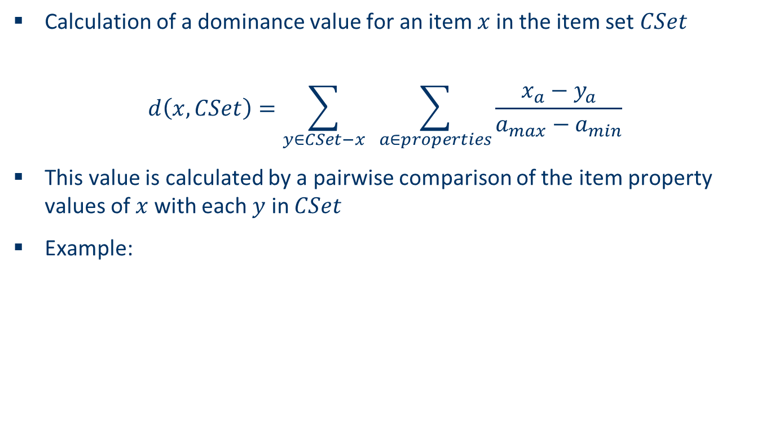
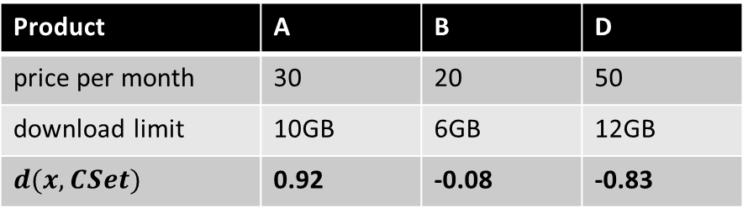
Calculate dominance relationships
Calculation of a dominance value for an item $x$ in the item set $CSet$
$$d\left(x,CSet\right)=\sum_{y∈CSet−x}{ \sum_{a∈properties}{\frac{x_{a}−y_{a}}{a_{max⁡}−a_{min}}}}$$
This value is calculated by a pairwise comparison of the item property values of $x$ with each $y$ in $CSet$
Example:
Product | A | B | D
price per month | 30 | 20 | 50
download limit | 10GB | 6GB | 12GB
$$d(x, CSet)$$ | 0.92 | -0.08 | -0.83

Slide 13
Primacy/recency effects as a cognitive phenomenon
Describe situations in which information units at the beginning (primary) and at the end (recency) of a list of items are more likely remembered than information units in the middle of the list
Primacy/recency effects in recommendation dialogs must be taken into account because different question sequences can potentially change the selection behavior of consumers

Slide 14
Primacy/recency effects as a decision phenomenon
Describe situations in which items presented at the beginning and at the end of a list are evaluated significantly more often compared with items in the middle of a list
The same phenomenon exists as well in the context of web search scenarios:
Web links at the beginning and the end of a list are activated significantly more often than those in the middle of the list
Typically, users are not interested in evaluating large lists of items to identify those that best fit their wishes and needs
Consequently, a recommender application must calculate rankings that reduce the cognitive overheads of a user as much as possible

Slide 15
Framing
Denotes the effect that the way a decision alternative is presented influences the decision behavior of the user
For example, the way pricing information is presented to a user significantly influences the way in which other attributes of a certain decision alternative are evaluated (price framing)
Attribute framing denotes the phenomenon that different but equivalent descriptions of a decision task lead to different final decisions
For example, consumers prefer to buy meat that is 80 percent lean compared with meat that is 20 percent fat
Consumers who are highly familiar with a specific type of product are less amenable to framing effects, as they have clear preferences that should be fulfilled by the recommended product

Slide 16
Priming
Denotes the idea of making some properties of a decision alternative more accessible in memory, with the consequence that this setting will directly influence the evaluations of a consumer
Background priming (Mandel and Johnson 1999) exploits the fact that different page backgrounds can directly influence the decision-making process
An example is provided by Mandel and Johnson (1999), in which one version of an online furniture selling environment had a background with coins and the second version had a cloudy background (cirrocumulus), which triggered feelings such as comfort or silence. Users who interacted with the first version chose significantly less expensive products compared with those who interacted with the cloudy-background version.
The reduction of questions in a recommendation dialog is another aspect of priming

Slide 17
Defaults
Play an important role in decision-making processes because people often tend to favor the status quo compared with other potentially equally attractive decision alternatives
Tendency to maintain decisions and being reluctant to change the current state is also called status quo bias
Potential changes to the current state are always related to some kind of losses or expected gains – and people are typically loss-averse
If default options are used in the presentation of decision alternatives, users are reluctant to change this setting (the current state)
Consumers tend to associate a certain risk with changing a default
→ Biases in decision processes
→ Reduce the overall interaction effort and actively support consumers in the product selection process

Slide 18
Personality and social psychology
Besides the cognitive and decision psychological phenomena, different personality properties pose specific requirements on the design of recommender user interfaces
Locus of control (LOC)
Need for closure (NFC)
Maximizer and satisficer (MaxSat)
Conformity
Trust
Emotions
Persuasion

Slide 19
Locus of control (LOC)
The amount a human being is able to control occurring events
Users should be able to decide on their own with which type of interface they prefer to interact
External LOC
Predefined and static dialogs better support users without a special interest in controlling the recommendation process
Internal LOC
More flexible dialogs better support users with a strong interest in controlling the recommendation process
More flexible recommender user interfaces not only let the user select the parameters they want to specify but also actively propose interesting parameters and feature settings

Slide 20
Need for closure (NFC)
Denotes the individual's need to arrive at a decision as soon as possible and to get feedback on how much effort is still needed to successfully complete a decision task
Inclusion of progress bars
Immediate display of temporary recommendation results such that the user has the flexibility to select an item for detailed inspection whenever he or she wants
Automated repair actions
Also refers to a tendency of people to prefer predictability and to narrow down the efforts of an information search as much as possible

Slide 21
Maximizer and satisficer (MaxSat)
Maximizers interacting with a recommender application typically need a longer time span for completing a session
Prefer to know many technical details about the product
Tend to identify an optimal solution that requires an exhaustive search over the available decision alternatives
Satisficers are searching for "good enough" solutions until one solution is found that is within an acceptability threshold
Example: Selection of TV channels:
Satisficers focus on the identification of a channel that offers the first acceptable program
Maximizers spend most of the time on selection activities such that, compared to satisficers, significantly less viewing time is available for them
Show more application-oriented (satisficers) or more technical explanations (maximizers)?

Slide 22
Conformity
Is a process in which a person's behaviors, attitudes, and beliefs are influenced by other people
Recommenders have the potential to affect users' opinions of items
Cosley et al. (2003) investigated whether the display of item predictions affects a user's rating behavior
The outcome of this experiment was that users confronted with a prediction significantly changed (adapted) their rating behavior
The changed rating behavior can be explained by the fact that the display of ratings simply influences people's beliefs
→ The recommender user interface can have a strong impact on a user’s rating behavior

Slide 23
Trust
Is an important factor that influences a consumer's decision whether to buy a product
In online sales environments trust is very hard to establish but easy to lose
A customer's willingness to buy or return to a web site are important trust-induced benefits
Major elements of a recommender user interface that support trust building are
explanations,
product comparisons,
and automated repair functionalities
Perceived level of trust is also influence by the overall quality of recommendations

Slide 24
Emotions
Are ignored by most of the existing recommender applications
An emotion can be defined as "a state usually caused by an event of importance to the subject". It typically includes
a conscious mental state with a recognizable quality of feeling and directed towards some object,
a bodily perturbation of some kind,
recognizable expressions of the face, tone of voice, and gesture
and a readiness for certain kinds of action" (Oatley and Jenkins 1996)
MovieProfiler (www.movieprofiler.com)
The search engine of MovieProfiler supports item search on the basis of an emotional profile specified by the user
A user indicates on a five-point psychometric scale which specific emotions should be activated by a film
Users are able to evaluate movies regarding the emotions fear, anger, sorrow, joy, disgust, acceptance, anticipation, and surprise

Slide 25
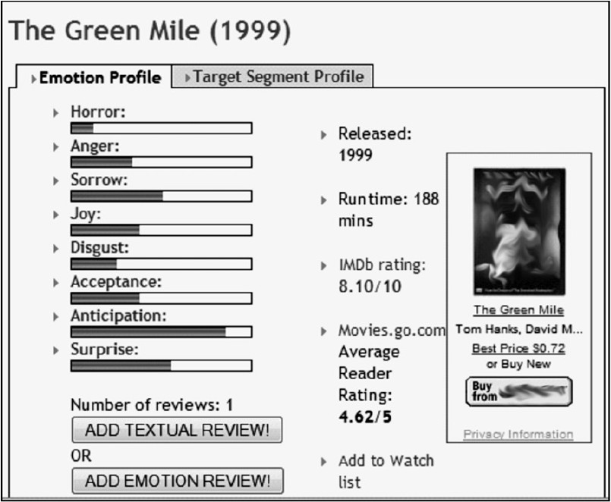
MovieProfiler (www.movieprofiler.com)

Slide 26
Persuasion
Recommender technologies can be interpreted as persuasive technologies in the sense of Fogg:
"Persuasive technology is broadly defined as technology that is designed to change attitudes or behaviors of the users through persuasion and social influence, but not through coercion" (Fogg 2003)
This interpretation is admissible primarily if recommendation technologies are applied with the goal of supporting (not manipulating) the customer in finding the product that fits his or her wishes and needs
Obviously, persuasive applications raise ethical considerations, as all of the effects mentioned here could be applied to stimulate the customer to purchase items that are unnecessary or not suitable

Slide 27
Discussion and summary
Research has clearly pointed out that preference stability in decision processes does not exist
Various forms of an online users' purchasing behavior were described
The understanding of online users' purchasing behavior is of high importance for companies
This purchasing behavior can be explained by different models of human decision making
The nonexistence of stable preferences led to the development of different alternative decision models
By taking the different models of human decision making into account, recommender systems are able to influence humans' decision process

Slide 28
Literature
[Chen and Pu 2005] Trust building in recommender agents, 1st International Workshop onWeb Personalisation, Recommender Systems and Intelligent User Interfaces (WPRSIUI ’05) (Reading, UK), 2005, pp. 135–145
[Chen and Pu 2008] A cross-cultural user evaluation of product recommender interfaces, Proceedings of the 2008 ACM Conference on Recommender Systems (RecSys ’08) (Lausanne, Switzerland), ACM, 2008, pp. 75–82
[Cosley et al. 2003] Is seeing believing? How recommender system interfaces affect users’ opinions, Proceedings of the SIGCHI Conference on Human Factors in Computing Systems (CHI ’03) (Fort Lauderdale, FL), 2003, pp. 585–592
[Felfernig et al. 2008] Persuasion in knowledge-based recommendation, Proceedings of the 2nd International Conference on Persuasive Technologies (Persuasive ’08) (Oulu, Finland), vol. 5033, Springer, 2008, pp. 71–82
[Fog 2003] Persuasive technology – using computers to change what we think and do, Morgan Kaufmann, 2003
[Gigerenzer 2007] Bauchentscheidungen, Bertelsmann Verlag, March 2007
[Mandel and Johnson 1999] Constructing preferences online: canweb pages change what you want?, Unpublished manuscript (Wharton School, University of Pennsylvania), 1999
[Oatley and Jenkins 1996] Understanding emotions, Blackwell, 1996
[Payne et al. 1993] The adaptive decision maker, Cambridge University Press, 1993
[Simon 1955] A behavioral model of choice, Quarterly Journal of Economics 69 (1955), no. 1, 99–118

